Slide 1
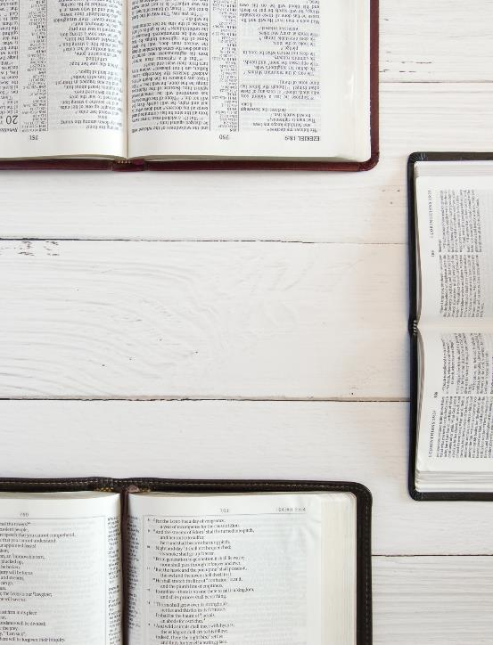
WELCOME TO
SUNDAY SCHOOL

Slide 5
Menu for April 24
$9 per person and $30 max per immediate family. Kids Meals are $5.
Entrée: Chicken Parmesan
Kids Meal: Corndogs
Salad: Chef Salad with Grilled Turkey

Slide 27
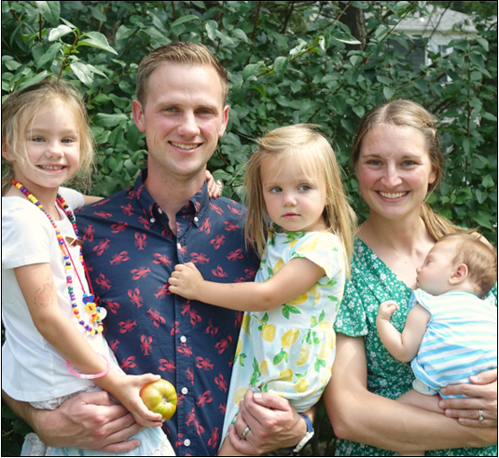
M
E
E
T
INDIVIDUAL PARTNERS
HUNTER & MEREDITH GUTHRIE
First Baptist Church
Medfield, Massachussets
Hunter and Meredith are revitalizing a church that was established in 1776 but dwindled to eight members when they arrived in 2019. They are praying that FBC Medfield be a thriving gospel light, and that they would be able to send people to revitalize other historic churches in their area who have lost the gospel.

Slide 28
P R A Y
INDIVIDUAL PARTNERS
HUNTER & MEREDITH GUTHRIE
We praise God for all that he has done in our church over the last four years. We would like to ask for prayer for our new leadership team, specifically for wisdom in our leading of the church. Also, please join us in praying that God would give our church a passion for the lost all around us so that we can be effective in making disciples.

Slide 29
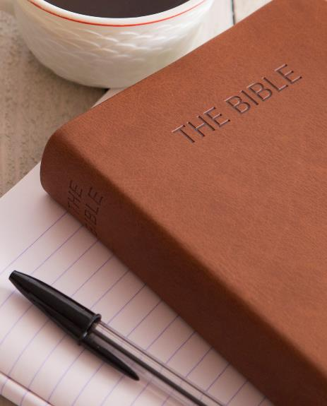
A Proposal on the
Threshing Floor
Ruth 3
April 21
Teacher’s Name

Slide 30
A PROPOSAL ON THE THRESHING FLOOR

Slide 31
BIGGEST HEADER 48 PT
Secondary Header 40 pt
THIRD HEADER 32 PT
Basic Font Size 28 pt

Slide 32
Bible Verse Sample Text. Bible Verse Sample Text. Bible Verse Sample Text. Bible Verse Sample Text. Bible Verse Sample Text. Bible Verse Sample Text. Bible Verse Sample Text. Bible Verse Sample Text. Bible Verse Sample Text. Bible Verse Sample Text. Bible Verse Sample Text. Bible Verse Sample Text. Bible Verse Sample Text. Bible Verse Sample Text. Bible Verse Sample Text. Bible Verse Sample Text.
BIBLE VERSE REFERENCE

Slide 33
SAMPLE HEADER
Bible Verse Sample Text. Bible Verse Sample Text. Bible Verse Sample Text. Bible Verse Sample Text. Bible Verse Sample Text. Bible Verse Sample Text. Bible Verse Sample Text. Bible Verse Sample Text. Bible Verse Sample Text. Bible Verse Sample Text. Bible Verse Sample Text. Bible Verse Sample Text. Bible Verse Sample Text. Bible Verse Sample Text. Bible Verse Sample Text. Bible Verse Sample Text.
BIBLE VERSE REFERENCE

Slide 34
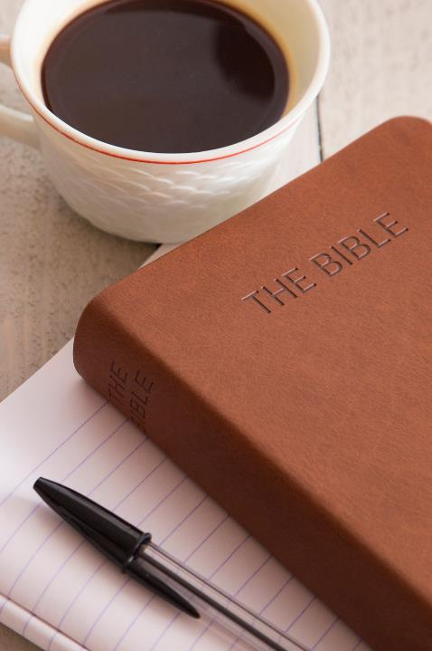
NEXT WEEK
April 28
Ruth 4
Workbook: Week 5 (p. 35-42)

